Slide 1
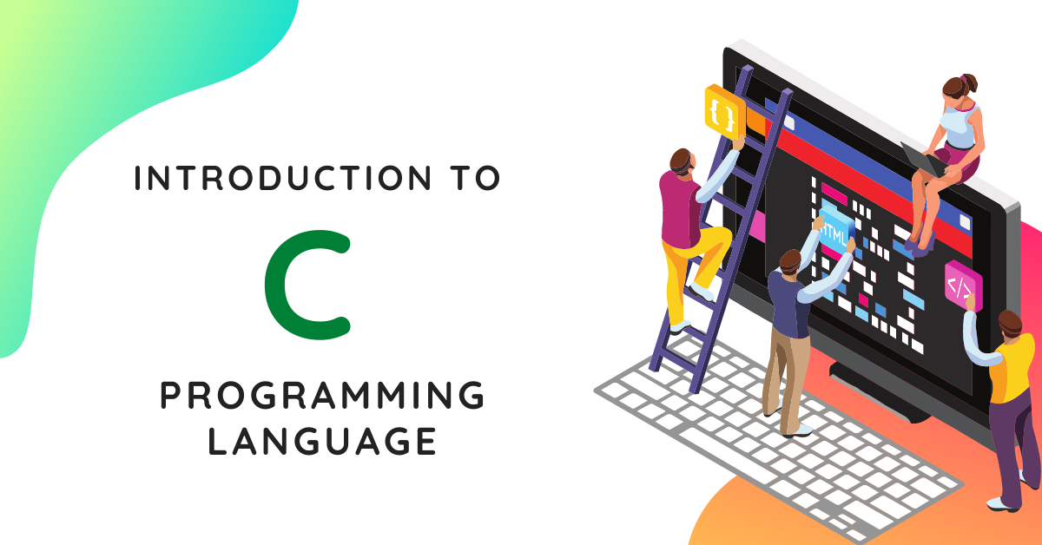
Introduction to C Programming

Slide 2


Shamimul Haque
About Me
B.Sc. In Information and Communication Engineering
Bangladesh Army University of Engineering & Technology

Slide 3

A short brief about the presentation
What is C Programming?
History of C
Where is C used
Why you should learn C
How C works
QNA Session

Slide 4


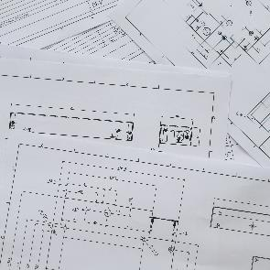



What is C?
1
2
C is a structured programming language that is extremely popular, and flexible to use. It is extensively used to write various applications, Operating Systems like Windows, and many other complex programs like Oracle database, Git, Python interpreter, and more.
It is also considered as the mother of programming language.
3
4
5
6

Slide 5
History of C language
In 1972, a great computer scientist Dennis Ritchie created a new programming language called ‘C’ at the Bell Laboratories. It was created from ‘ALGOL’, ‘BCPL’ and ‘B’ programming languages. ‘C’ programming language contains all the features of these languages and many more additional concepts that make it unique from other languages.

Slide 6
Where is C used?
‘C’ language is widely used in embedded systems.
It is used for developing system applications.
It is widely used for developing desktop applications.
Most of the applications by Adobe are developed using ‘C’ programming language.
It is used for developing browsers and their extensions. Google’s Chromium is built using ‘C’ programming language.
It is used to develop databases. MySQL is the most popular database software which is built using ‘C’.
It is used in developing an operating system. Operating systems such as Apple’s OS X, Microsoft’s Windows, and Symbian are developed using ‘C’ language. It is used for developing desktop as well as mobile phone’s operating system.
It is used for compiler production.
It is widely used in IOT applications.

Slide 7
Why learn C Language?
As we studied earlier, ‘C’ is a base language for many programming languages. So, learning ‘C’ as the main language will play an important role while studying other programming languages. It shares the same concepts such as data types, operators, control statements and many more. ‘C’ can be used widely in various applications. It is a simple language and provides faster execution. There are many jobs available for a ‘C’ developer in the current market.

Slide 8
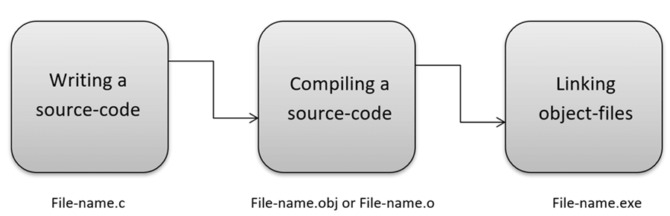
How C Programming Language Works?
C is a compiled language. A compiler is a special tool that compiles the program and converts it into the object file which is machine readable. After the compilation process, the linker will combine different object files and creates a single executable file to run the program. The following diagram shows the execution of a ‘C’ program

Slide 9
Summary
‘C’ was developed by Dennis Ritchie in 1972.
It is a robust language.
It is a low programming level language close to machine language
It is widely used in the software development field.
It is a procedure and structure oriented language.
It has the full support of various operating systems and hardware platforms.
Many compilers are available for executing programs written in ‘C’.
A compiler compiles the source file and generates an object file.
A linker links all the object files together and creates one executable file.
It is highly portable.

Slide 10

Any Questions?

Slide 11

Thank You
Shamimul Haque
Shamim@shamimul.com

